Slide 1
Motor Control
Bruno Cornil

Slide 2
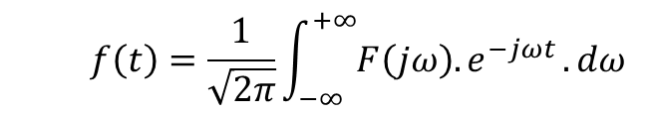
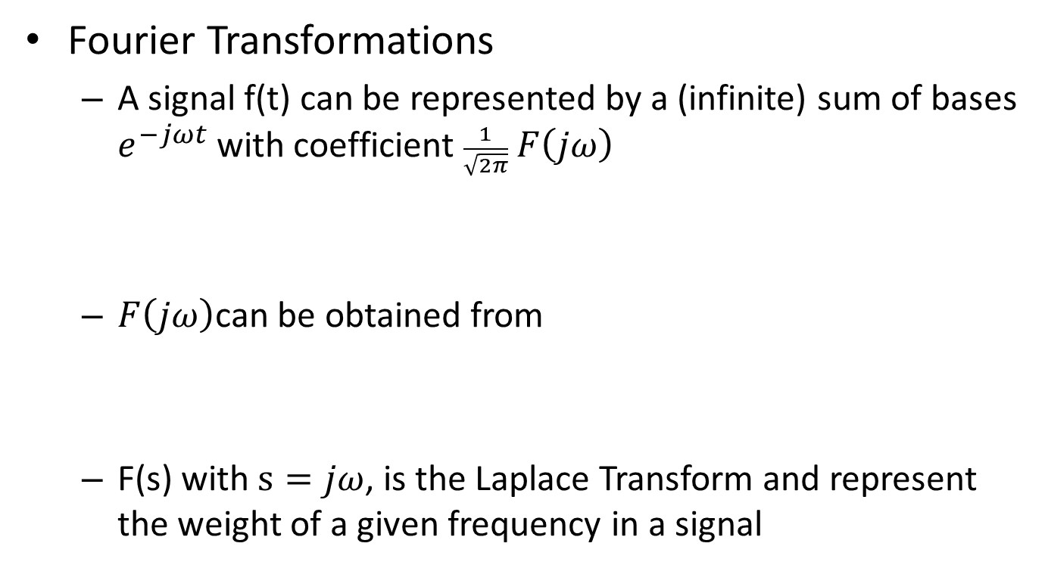
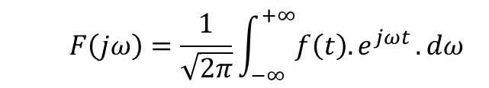
Control Theory
Fourier Transformations
A signal f(t) can be represented by a (infinite) sum of bases $e^{−jωt}$ with coefficient $\frac{1}{\sqrt{2π}} F\left(jω\right)$
$F\left(jω\right)$can be obtained from
F(s) with $s=jω$, is the Laplace Transform and represent the weight of a given frequency in a signal
$$f\left(t\right)=\frac{1}{\sqrt{2π}}\int_{−∞}^{+∞}{F\left(jω\right){.e}^{−jωt}.dω}$$
$$F\left(jω\right)=\frac{1}{\sqrt{2π}}\int_{−∞}^{+∞}{f\left(t\right){.e}^{jωt}.dω}$$

Slide 3
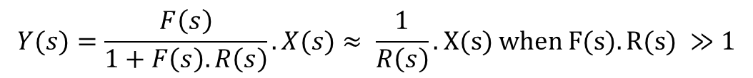

Control Theory
Closed-loop regulation
+
$$ε$$
F(s)
X(s)
Y(s)
-
1. Measure output
2. Compare with reference
R(s)
$$Y(s)=F(s).ε=F(s). \left(X(s)−R(s).Y(s)\right)$$
$$Y(s)=\frac{F\left(s\right)}{1+F\left(s\right).R\left(s\right)}.X(s)≈ \frac{1}{R\left(s\right)}. X(s) when F(s).R(s) ≫1$$
Close loop-gain = $F\left(s\right).R\left(s\right)≠−1(= e^{iπ})$ for any frequency (s) !

Slide 4
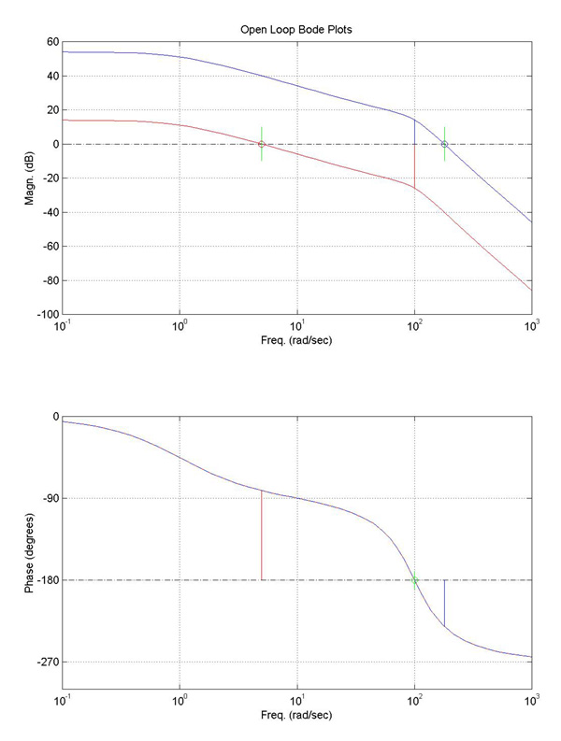
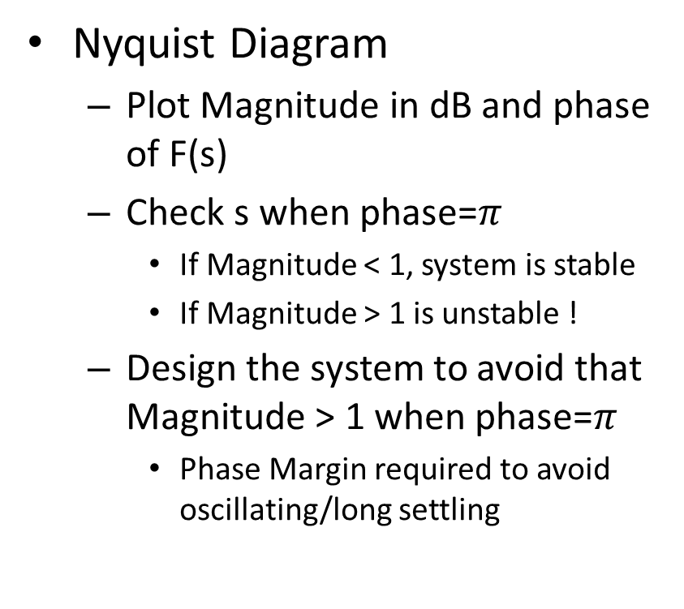

Control Theory
Nyquist Diagram
Plot Magnitude in dB and phase of F(s)
Check s when phase=$π$
If Magnitude < 1, system is stable
If Magnitude > 1 is unstable !
Design the system to avoid that Magnitude > 1 when phase=$π$
Phase Margin required to avoid oscillating/long settling
unstable
Mag=1 (0dB)
stable
Phase margin
Phase=$π$

Slide 5
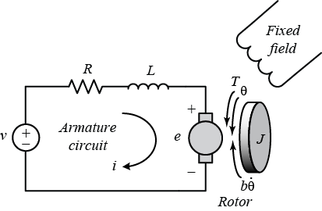


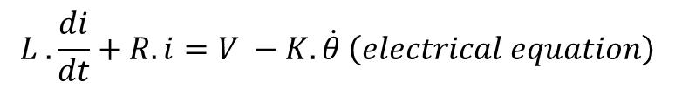
Motor Control
DC Motor Model
J : Motor moment of inertia
b: Friction constant
K : EMF/Torque force
R : Winding electric resistance
L : Winding electric inductance
$$J. \ddot{θ}+b.\dot{θ}=K. i \left(mechanical equation\right)$$
$$L .\frac{di}{dt}+R. i=V −K.\dot{θ} \left(electrical equation\right)$$
$$s.\left(s.J+b\right).θ\left(s\right)=K.i(s)$$
Laplace Transform
$$\left(L.s+R\right).i\left(s\right)=V\left(s\right)−K.s.θ \left(electrical equation\right)$$

Slide 6

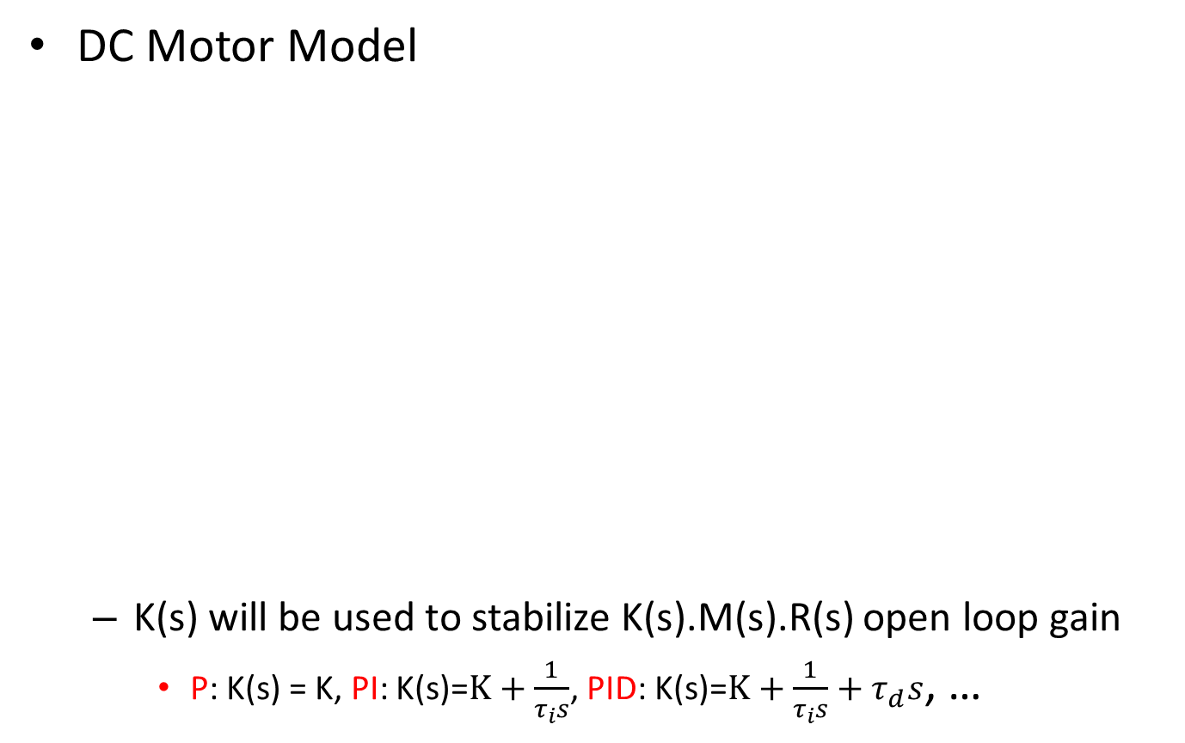



Motor Control
DC Motor Model
K(s) will be used to stabilize K(s).M(s).R(s) open loop gain
P: K(s) = K, PI: K(s)=$K+\frac{1}{τ_{i}s}$, PID: K(s)=$K+\frac{1}{τ_{i}s}+τ_{d}s$, …
Motor speed (rad/s) = $\dot{θ }\left(s\right)=s.θ\left(s\right)= \frac{K}{\left(J.s+b\right).\left(L.s+R\right)+K^{2}}. V\left(s\right)=M\left(s\right).V(s)≠\frac{1}{K}.V(s)$
F(s)
+
$$ε$$
K(s)
(filter)
$$V(s)$$
M(s)
(motor)
$${\dot{θ }}_{in}\left(s\right)$$
$${\dot{θ }}_{out}\left(s\right)$$
-
R(s)
(encoder)

